Slide 1
Module 5
Network Security and Applications
Notes:
1

Slide 2
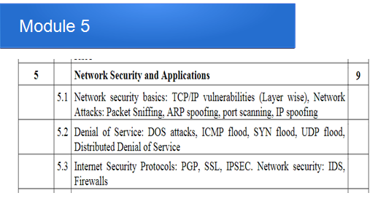
Module 5
Notes:
2

Slide 3
Why do we need security?
Protect vital information while still allowing access to those who need it
Trade secrets, medical records, etc.
Provide authentication and access control for resources
Guarantee availability of resources
3
Notes:
2

Slide 4
Network Security
Computer networks are typically a shared resource used by many applications representing different interests.
The Internet is particularly widely shared, being used by many people including opportunistic criminals.
Unless security measures are taken, a network conversation or a distributed application may be compromised by an adversary
4
Notes:
3

Slide 5
Who is vulnerable?
Financial institutions and banks
Internet service providers
Pharmaceutical companies
Government and defense agencies
Contractors to various government agencies
Multinational corporations
ANYONE ON THE NETWORK
5
Notes:
4

Slide 6
Network Reconnaissance
Network Reconnaissance means obtaining information about the victim
Network Reconnaissance, an "exploration or enumeration of network infrastructure including network addresses, available communication ports, and available services“
6
Notes:
5

Slide 7
Vulnerability scanner
A vulnerability scanner is a computer program designed to assess computers, computer systems, networks or applications for weaknesses.
Types:-
Port scanner (e.g. Nmap)
Network vulnerability scanner (e.g. Nessus)
Web application security scanner
Database security scanner
Host based vulnerability scanner (Lynis)
ERP security scanner (ERPScan)
Single vulnerability tests
7
Notes:
6

Slide 8
Common security attacks and their countermeasures
Finding a way into the network
Firewalls (iptables)
Exploiting software bugs, buffer overflows
Intrusion Detection Systems
Denial of Service
Ingress filtering, IDS (snort)
TCP hijacking
IPSec
Packet sniffing
Encryption (SSH, SSL, HTTPS)
Social problems
Education
8
Notes:
7

Slide 9
Denial of Service
Purpose: Make a network service unusable, usually by overloading the server or network
Many different kinds of DoS attacks:
SYN flooding
Smurf
Distributed attacks
9
Notes:
8

Slide 10
SYN flooding- Denial of Service
The attack involves having a client repeatedly send SYN (synchronization)packets to every port on a server, using fake IP addresses.
The server responds to each attempt with a SYN/ACK (synchronization acknowledged) packet from each open port, and with a RST (reset) packet from each closed port.
In a SYN flood, the ACK packet is never sent back by the hostile client.
Instead, the client program sends repeated SYN requests to all the server's ports.
A hostile client always knows a port is open when the server responds with a SYN/ACK packet.
10
Notes:
9

Slide 11
Smurf
A smurf attack is an exploitation of the Internet Protocol(IP) broadcast addressing to create a denial of service.
The attacker uses a program called Smurf to cause the attacked part of a network to become inoperable.
The smurf program builds a network packet that appears to originate from another address (this is known as spoofing an IP address).
This packet contains an ICMP ping message that is addressed to an IP broadcast address.
The echo responses to the ping message are sent back to the "victim" address.
Enough pings and resultant echoes can flood the network making it unusable for real traffic.
11
Notes:
11

Slide 12
Distributed DOS
In a typical DDoS attack, the attacker begins by exploiting a vulnerability in one computer system and making it the DDoS master.
The attack master, identifies and infects other vulnerable systems with malware.
Eventually, the attacker instructs the controlled machines to launch an attack against a specified target.
A computer under the control of an intruder is known as a zombie
12
Notes:
13

Slide 13
Defenses Against DOS attacks
Investigate the incoming packets and look for a particular pattern. If such a pattern emerges, the try blocking incoming packets from the concerned IP address
Configure the services offered by an application in such a way that it never accepts more than a particular number of requests in a specified time interval
Block a particular IP address, port number or a combination of these.
Install a firewall
Keep backup servers ready

Slide 14
ICMP Flood
A ICMP flood or ping flood is a denial-of-service attack in which the attacker attempts to overload a targeted device with ICMP echo-request packets, causing the target to become inaccessible to normal traffic.
The attacker sends many ICMP echo request packets to the targeted server using multiple devices.
The targeted server then sends an ICMP echo reply packet to each requesting device’s IP address as a response.
Notes:
15

Slide 15
UDP Flood
UDP flood” is a type of Denial of Service (DoS) attack in which the attacker overloads random ports on the targeted host with IP packets containing UDP datagrams.
The receiving host checks for applications associated with these datagrams and—finding none—sends back a “Destination Unreachable” packet.
As more and more UDP packets are received and answered, the system becomes overloaded and unresponsive to other clients.
In the framework of a UDP flood attack, the attacker may also spoof the IP address of the packets, both to make sure that the return ICMP packets don’t reach their host, and to anonymize the attack.
Notes:
16

Slide 16
Port Scanning
A port scan is an attack that sends client requests to a range of server port addresses on a host, with the goal of finding an active port and exploiting a known vulnerability of that service.
The idea behind port scan is to probe as many listeners as possible, and keep track of the ones that are receptive or useful to your particular need.
Notes:
17

Slide 17
Port Scanning
Types of scan:-
Ping scan
SYN scan
FIN scan
Stealth scan
X-mas scan
Notes:
18

Slide 18
Spoofing attacks
A spoofing attack is when a malicious party impersonates another device or user on a network in order to launch attacks.
These attacks can be against network hosts, steal data, spread malware or bypass access controls.
Different types of spoofing attacks:-
IP address spoofing attacks
ARP spoofing attacks and
DNS server spoofing attacks.
Notes:
19

Slide 19
DNS Spoofing
DNS Cache Poisoning is one of the ways to achieve DNS Spoofing
The cache of a DNS name server is poisoned with false information
A poisoned DNS cache does not redirect traffic to the legitimate IP address when resolving a domain name
Many end users use the same cache, where the registries that are stored correlate each IP address with a domain.
Attackers manage to manipulate a DNS entry in this registry,
The internet service providers that use this cache would accept it as authentic, even if it has been manipulated to point to a fake website.
Notes:
20

Slide 20
IP Spoofing
An attacker sends IP packets from a false (or “spoofed”) source address in order to disguise itself.
Denial-of-service attacks often use IP spoofing to overload networks and devices with packets that appear to be from legitimate source IP addresses.
Notes:
21

Slide 21
IP Spoofing
There are two ways that IP spoofing attacks can be used to overload targets with traffic.
One method is to simply flood a selected target with packets from multiple spoofed addresses.
This method works by directly sending a victim more data than it can handle.
Notes:
22

Slide 22
IP Spoofing
The other method is to spoof the target’s IP address and send packets from that address to many different recipients on the network.
When another machine receives a packet, it will automatically transmit a packet to the sender in response.
Since the spoofed packets appear to be sent from the target’s IP address, all responses to the spoofed packets will be sent to (and flood) the target’s IP address.
Notes:
23

Slide 23
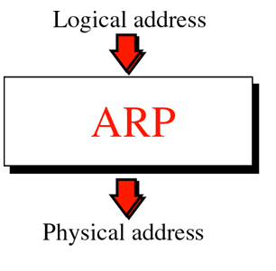
Address Resolution Protocol (ARP)

Slide 24
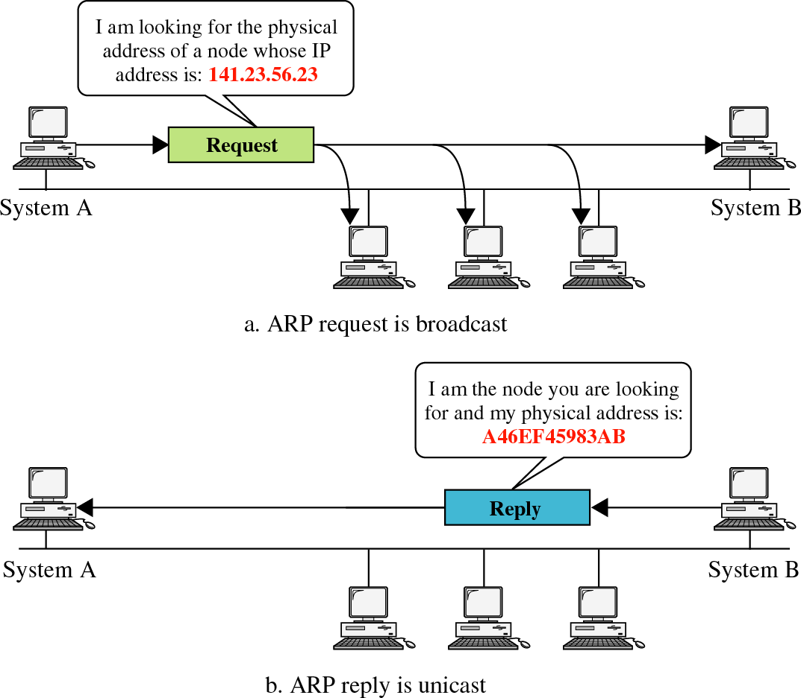
Address Resolution Protocol (ARP)

Slide 25
ARP
To avoid having to send an ARP request packet each time, a host can cache the IP and the corresponding host addresses in its ARP table (ARP cache).
When a computer receives an ARP reply, it will update its ARP cache.
ARP is a stateless protocol, most operating systems will update their cache if a reply is received, regardless of whether they have sent out an actual request.
25
Notes:
26
26
26

Slide 26
ARP Spoofing
Construct spoofed ARP replies.
A target computer could be convinced to send frames destined for computer A to instead go to computer B.
Computer A will have no idea that this redirection took place.
This process of updating a target computer’s ARP cache is referred to as “ARP poisoning”.
26
Notes:
27
27
27

Slide 27
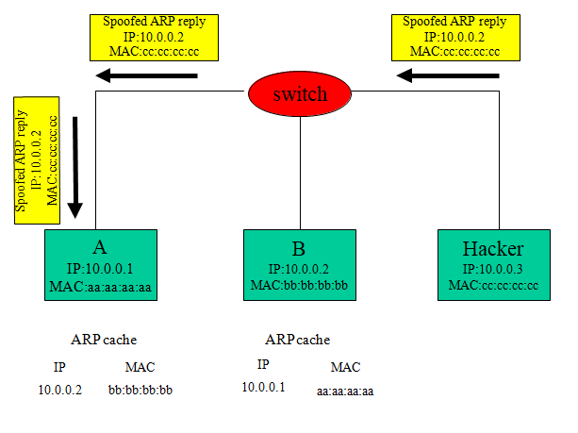
ARP Spoofing
27
Notes:
28
28
28

Slide 28
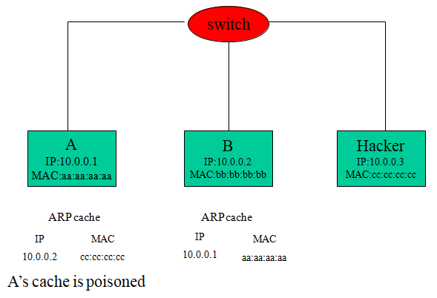
ARP Spoofing
28
Notes:
29
29
29

Slide 29
ARP Spoofing
ARP is used to resolve IP addresses to MAC addresses.
In an ARP spoofing attack, a malicious party sends spoofed ARP messages across a local area network in order to link the attacker’s MAC address with the IP address of a legitimate member of the network.
This type of spoofing attack results in data that is intended for the host’s IP address getting sent to the attacker instead.
Notes:
30

Slide 30
ARP Spoofing
Malicious parties commonly use ARP spoofing to:-
steal information
modify data-in-transit or
stop traffic on a LAN.
ARP spoofing attacks can also be used to facilitate other types of attacks, including:
denial-of-service,
session hijacking and
man-in-the-middle attacks.
Notes:
31

Slide 31
Packet Sniffing
Packet sniffing is a technique of capturing packets that flows in the network
The software or device used to do this is called a packet sniffer.
Example:- tcpdump, wireshark
31
Notes:
32
32
32

Slide 32
Packet Sniffing
What kind of data can we get?
OR what kind of information would be most useful to a malicious user?
Answer: Anything in plain text
Passwords are the most popular
32
Notes:
33
33
33

Slide 33
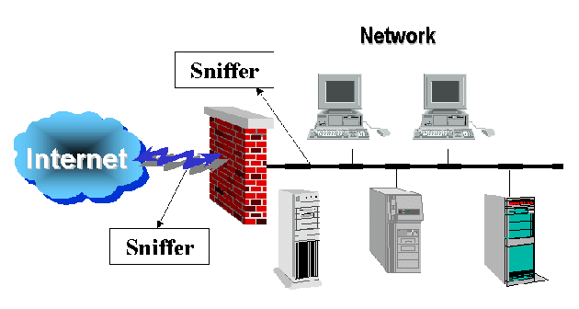
Packet Sniffer
33
Notes:
35
35
35

Slide 34
Why are Packet Sniffers used?
Detection of clear-text passwords and usernames from the network.
Conversion of data to human readable format so that people can read the traffic.
Performance analysis to discover network bottlenecks.
Troubleshoot network related problems
Network intrusion detection in order to discover hackers.
34
Notes:
36
36
36

Slide 35
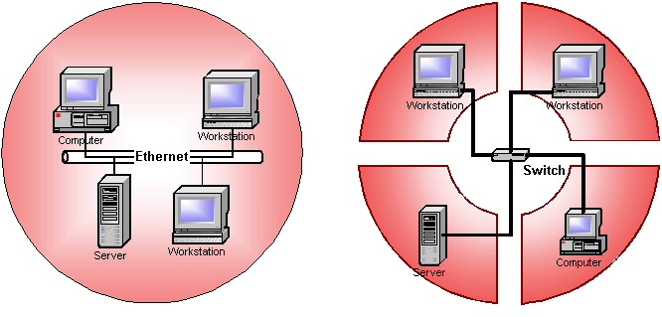
Packet Sniffers-Working
Packet sniffer works in two types of environment
Shared Ethernet
Switched Ethernet
35
Notes:
37
37
37

Slide 36
Packet Sniffers-Working
Shared Ethernet
In a shared Ethernet environment, all the systems are connected to the same bus
They are in the same broadcast domain.
When a message is to be sent to a machine, it is broadcasted over the network and the machine for which the message is intended, reads the message.
A machine running a sniffer, runs in “promiscuous mode” and can listen to all the traffic on the network.
This type of sniffing is extremely difficult to detect
36
Notes:
38
38
38

Slide 37
Packet Sniffers-Working
Switched Ethernet
In this environment, the machines are connected to a switch.
The switch maintains a MAC table and keeps a track of each computer’s MAC address and the physical port on the switch to which the MAC address maps
The packets are not broadcasted, but instead are specifically sent to the machines for which they are intended.
37
Notes:
39
39
39

Slide 38
Packet Sniffers-Working
Switched Ethernet
Even though a switched Ethernet is more secure than a shared one (using hub), it is not complete secure
One can still sniff the traffic using techniques like ARP spoofing, which basically spoofs the MAC address of the gateway and makes the traffic route through the machine running the sniffer
38
Notes:
40
40
40

Slide 39
Session hijacking
Attacker gets access to a session between two hosts
The attacker steals a valid session id which is used to get into the session and he uses this to snoop data
Session can be hijacked only after the hosts have authenticated successfully
Session cannot be initiated until the authentication process is finished
Since most authentication occurs at the start of the session, this allows attackers to gain access to a machine
39
Notes:
39
39
39

Slide 40
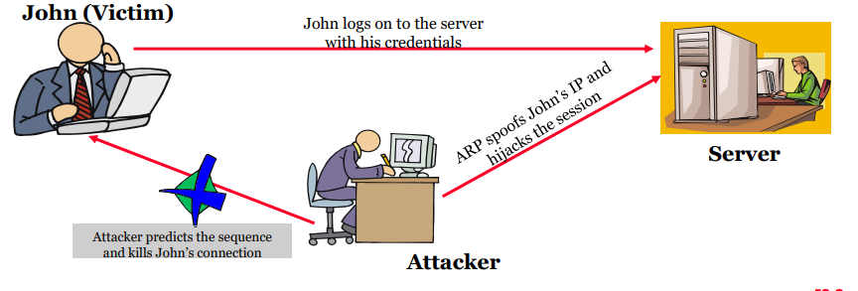
Session hijacking
40
Notes:
39
39
39

Slide 41
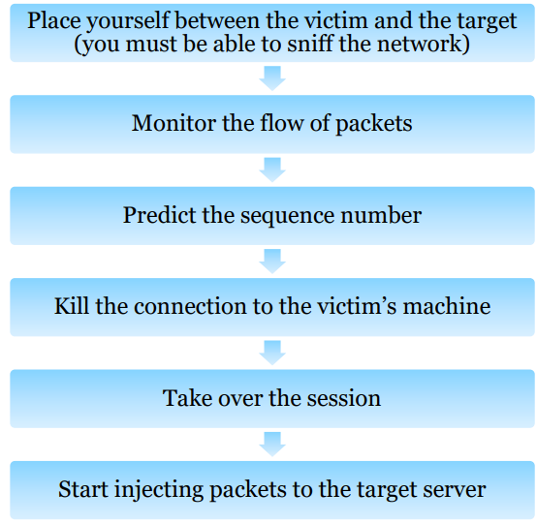
Session hijacking-Steps
41
Notes:
39
39
39

Slide 42
TCP hijacking
If an attacker learns the associated TCP state for the connection, then the connection can be hijacked.
Attacker can insert malicious data into the TCP stream, and the recipient will believe it came from the original source
Ex. Instead of downloading and running new program, you download a virus and execute it
42
Notes:
41
41
41

Slide 43
TCP hijacking
How do we prevent this?
IPSec
It provides source authentication. Hence Eve (attacker) cannot pretend to be Alice
It Encrypts data before transport, so Eve (attacker) cannot talk to Bob without knowing what the session key is
43
Notes:
42

